Slide 1
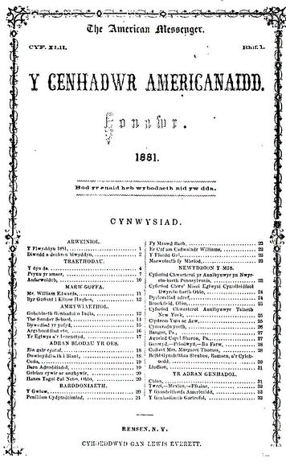
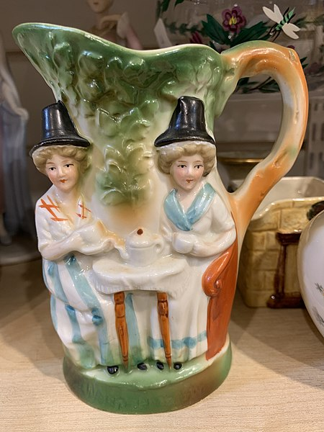
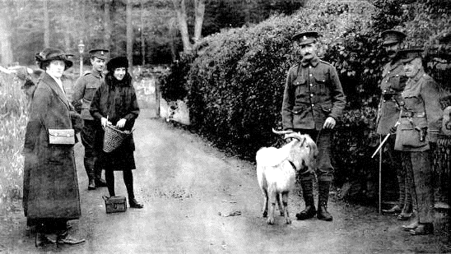
Amgueddfeydd, Archifau a Llyfrgelloedd Astudiaethau Lleol Cymru
Museums, Archives and Local Studies Libraries of Wales
Gweithio mewn partneriaeth ag ysgolion i ddarparu:
Rhagoriaeth addysgol
Cwricwllwm newydd i Gymru
Addysgu hanes Pobl Dduon, Asiaidd a lleiafrifoedd ethnig
Working in partnership with schools to deliver:
Educational excellence
The new Curriculum for Wales
The teaching of Black, Asian and minority ethnic histories
www.gem.org.uk GEM Wales/Cymru

Slide 2
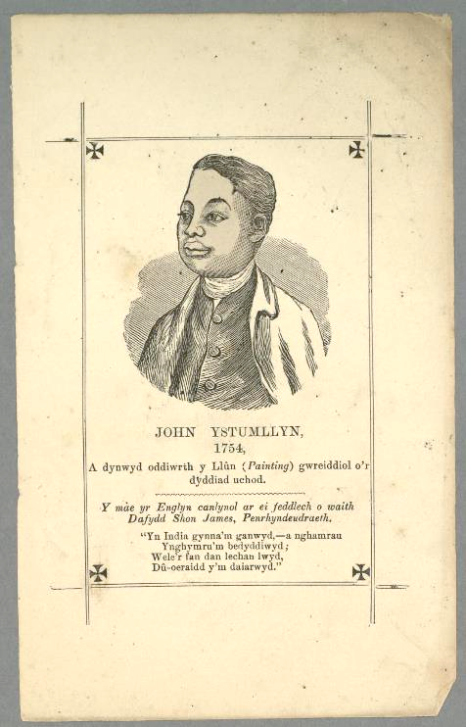
Cyfleoedd a heriau
Ysbrydolwn plant i fod eisiau dysgu
We inspire children to want to learn
Opportunities and challenges
Y CWRICWLWM NEWYDD
Mae’n cynnig cyfleoedd cyffrous i ysgolion ledled y wlad fynd yn bartner ag amgueddfeydd, llyfrgelloedd astudiaethau lleol ac archifau i gyflwyno rhagoriaeth addysgol.
Gall fod yn heriol datblygu rhaglenni addysgol newydd heb y cymorth cywir.
Mae gennym yr adnoddau i’ch helpu i gyflwyno cynefin, pob Maes Dysgu ac ar addysgu hanes Pobl Ddu, Asiaidd a lleiafrifoedd ethnig
.
THE NEW CURRICULUM FOR WALES
Offers exciting opportunities for schools across the country to partner with museums, local studies libraries and archives to deliver educational excellence.
It can be challenging developing new educational programmes without the right support.
We have the resources to help you deliver on cynefin, all Areas of Learning and on the teaching of Black, Asian and minority ethnic histories.

Slide 3
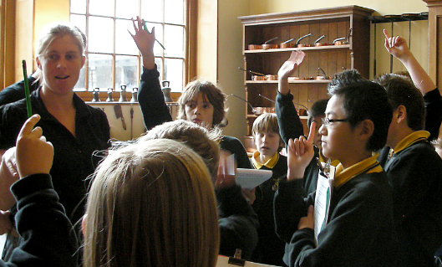
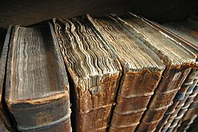
Pam dod atom ni
Why come to us
Ein tair buddigoliaeth fawr
Our big three wins
Ein STAFF Gallwn eich helpu i gael y gorau o'n casgliadau
Ein CASGLIADAU Rhyngom, mae gennym filiynau o wrthrychau gwreiddiol, ffotograffau, dogfennau, llyfrau, hanesion llafar, a llawer mwy
EIN GOFODAU Golygfeydd, arogleuon, cyffyrddiad - profiadau unigryw i gyffroi meddyliau ifanc, chwilfrydig
Our STAFF We can help you get the best out of our collections
Our COLLECTIONS Between us, we have millions of original objects, photographs, documents, books, oral histories, and much more
Our SPACES Sights, smells, touch – unique experiences to excite young, curious minds

Slide 4
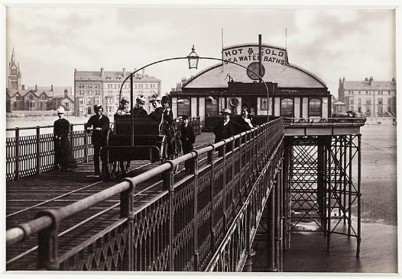
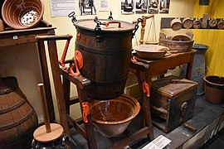
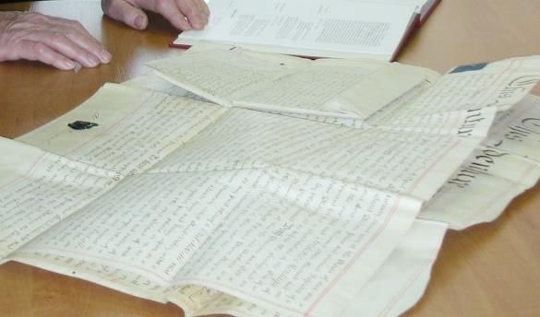
Pwy ydym ni
Who we are
Amgueddfeydd
Dros 100 ledled Cymru. Diddordeb mawr, bach, cyffredinol ac arbennig. Dim ond ychydig bach o’n casgliadau sydd i’w gweld – holwch ni am y gweddill.
Archifau
Mawr a bach – o bapurau Newydd cenedlaethol mawr a chofnodion sirol i gasgliadau prifysgolion neu ddiddordebau arbennig. Cofnodion gwreiddiol yn mynd yn ôl cannoedd o flynyddoedd.
Llyfrgelloedd astudiaethau lleol
Casgliadau cyfeirio yn cwmpasu pob agwedd ar eich ardal leol. Hanes cymdeithasol, diwydiannol a gwledig, gweithiau gan awduron lleol, ffotograffau, casgliadau unigryw.
Museums
Over 100 across Wales.
Big, small, general and special interest. Only a small amount of our collections are on show – ask us about the rest.
Archives
Large and small – from big nationals and county records to university or special interest collections. Original records going back hundreds of years.
Local study libraries
Reference collections covering all aspects of your local area. Social, industrial and rural history, works by local authors, photographs, unique collections.

Slide 5
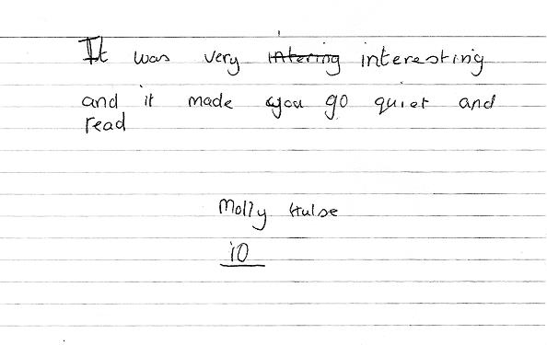
Rydyn ni eisiau gweithio gyda chi i ddathlu a dysgu o orffennol cyfoethog ein cymuned
We want to work with you to actively celebrate and learn from our community’s rich past
Pam dod atom ni
Why come to us
Rhyngom, mae calon cymuned gennym.
Defnyddiwch ni i archwilio eich ardal leol, sut mae'r byd wedi effeithio arno a sut mae pobl oddi yno wedi effeithio ar y byd.
Defnyddiwch ni i ymchwilio i hanes pobl Dduon, Asiaidd a lleiafrifoedd ethnig yn eich ardal nad ydych efallai wedi dod ar eu traws o'r blaen.
Defnyddiwch ni i ysgogi plant o bob oed a gallu i fod eisiau dysgu.
Between us, we hold the heart of a community.
Use us to explore your locality, how the world impacted on it and how people from there impacted on the world.
Use us to delve into Black, Asian and minority ethnic histories in your area you might not have come across before.
Use us to motivate children across all ages and abilities to want to learn.

Slide 6
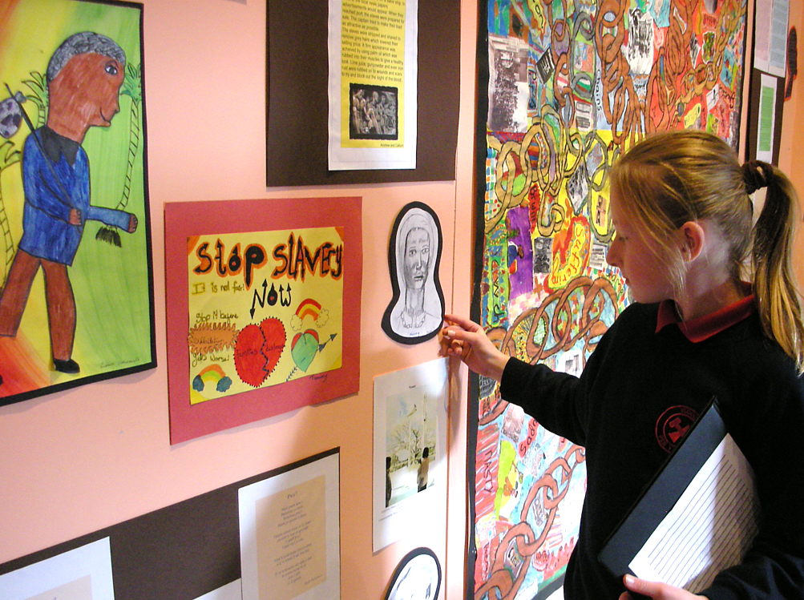
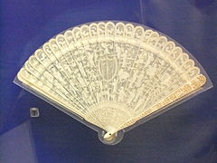
Meysydd dysgu a phrofiad – Ieithoedd, llythrennedd a chyfathrebu
Area of learning and experience – Language, literacy and communication
Deall dogfennau hanesyddol
Archwilio iaith dros amser
Rhannu canfyddiadau
Understanding historical documents
Exploring language over time
Sharing findings

Slide 7
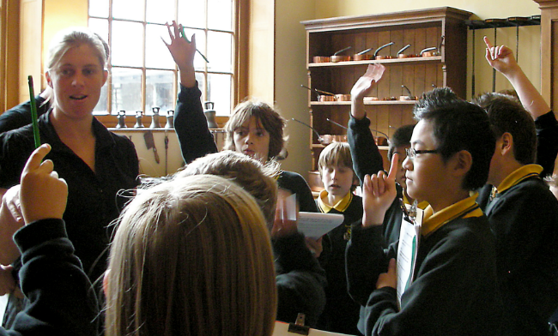
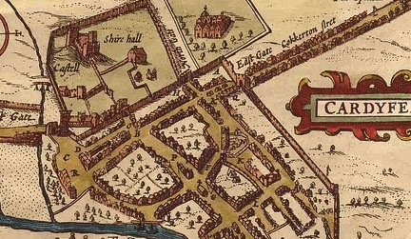
Maes dysgu a phrofiad – Y dyniaethau
Area of learning and experience – Humanities
Hanes – lleol a rhyngwladol, gwleidyddol, cymdeithasol, economaidd a phersonol. Creu cysylltiadau rhwng y gorffennol a'r presennol.
Daearyddiaeth – mapiau, dogfennau teithio, rheoli tir. Deall y byd naturiol.
Addysg Grefyddol – diwylliannau'n dod at ei gilydd dros amser. Defnyddio ein heitemau i archwilio moeseg a gwneud penderfyniadau, deall hanesion cymhleth sydd wedi’u llunio gan weithredoedd a chredoau dynol.
History – local and international, political, social, economic and personal. Making connections between the past and the present.
Geography – maps, travel documents, land management. Understanding the natural world.
RE – cultures coming together through time. Using our items to explore ethics and decision-making, understanding complex histories that have been shaped by human actions and beliefs.

Slide 8
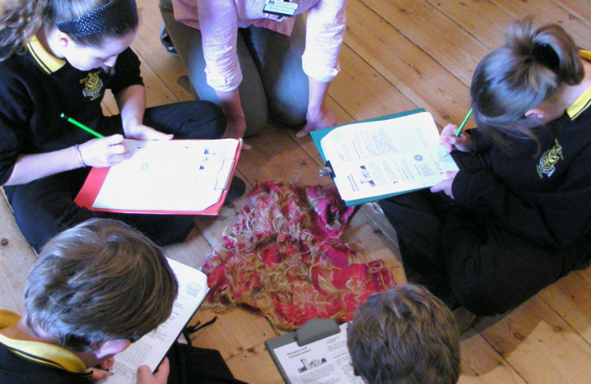
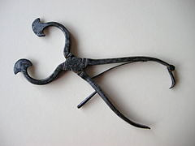
Maes dysgu a phrofiad – Gwyddoniaeth a thechnoleg
Area of learning and experience – Science and technology
Datblygiad gwyddonol a thechnolegol dros y canrifoedd
Ymchwilio i'n catalogau a'n cronfeydd data
Archwilio canfyddiadau yn feirniadol, cofnodi data
Archwilio ein rheolaethau amgylcheddol
Darparu dealltwriaeth byd go iawn o gysyniadau gwyddonol sy'n berthnasol i fywyd
Scientific and technological development over the centuries
Researching our catalogues and databases
Critically exploring findings, recording data
Exploring our environmental controls
Providing real world understanding of scientific concepts applied to life

Slide 9
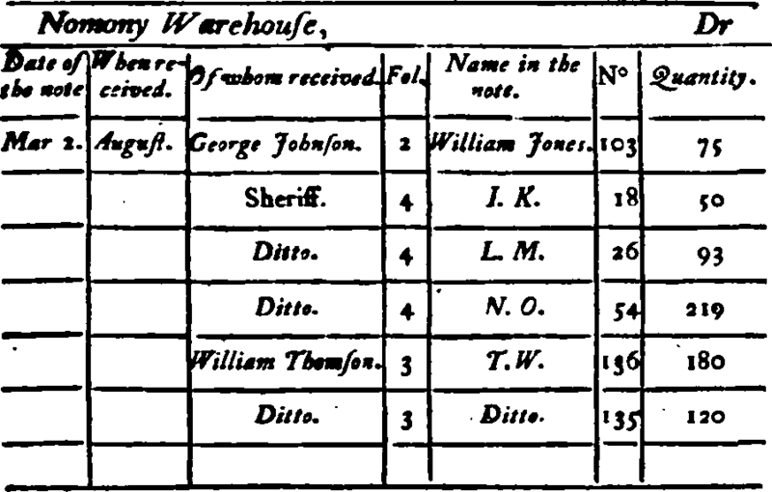
Maes dysgu a phrofiad – Mathemateg a rhifedd
Area of learning and experience – Maths and numeracy
Rheoli data
Ymchwilio i ddata hanesyddol
Deall dogfennau hanesyddol
Annog meddwl mathemategol trwy archwilio cysyniadau
Datblygu sgiliau gwybyddol wrth archwilio deunydd newydd
Paratoi plant ar gyfer y dyfodol gyda dealltwriaeth byd go iawn o fathemateg
Managing data
Researching historical data
Understanding historical documents
Encouraging mathematical thinking through exploring concepts
Develop cognitive skills while exploring new material
Preparing children for the future with real world understanding of maths

Slide 10
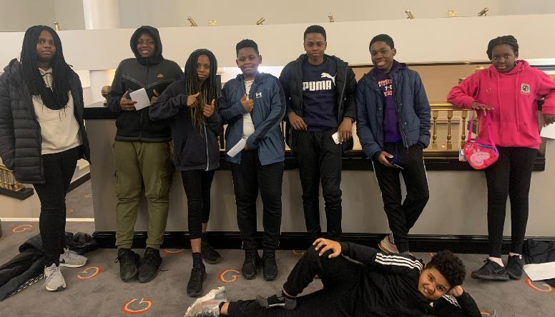
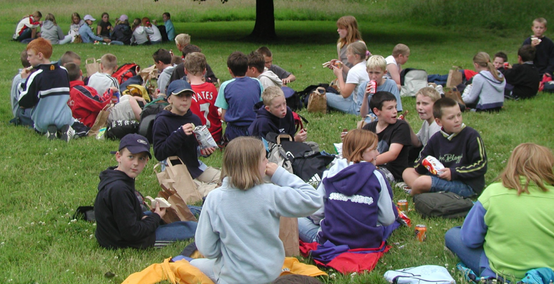
Meysydd dysgu a phrofiad – Iechyd a lles
Area of learning and experience – Health and wellbeing
Dysgu y tu allan i'r ystafell ddosbarth
Dysgu am glefydau a gofal iechyd y gorffennol
Ymateb i ysgogiadau newydd mewn amgylcheddau newydd
Dysgu am gymunedau rhyng-gysylltiedig
Learning outside of the classroom
Learning of past diseases and healthcare
Responding to new stimuli in new environments
Learning about interconnected communities

Slide 11
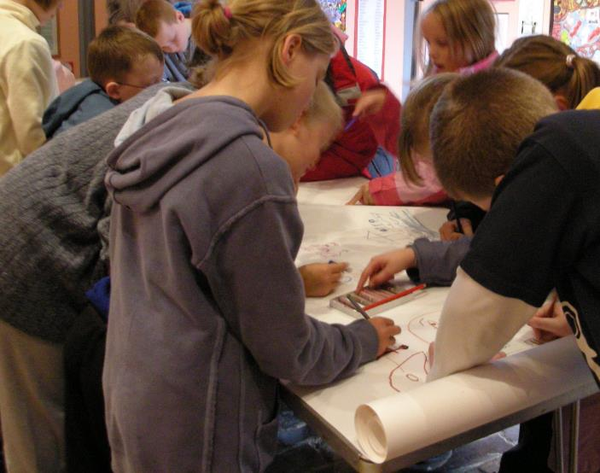
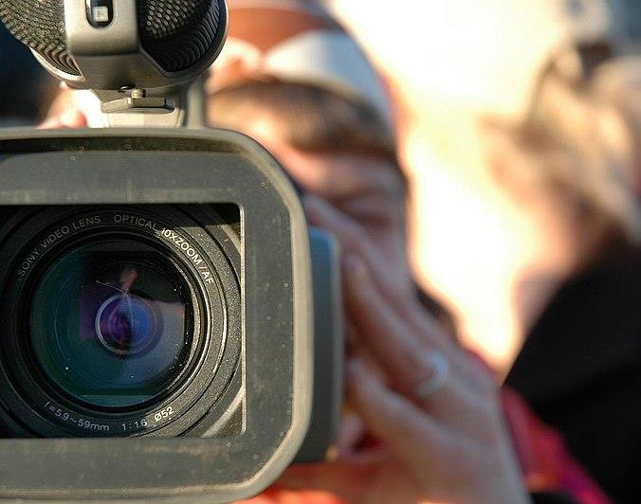
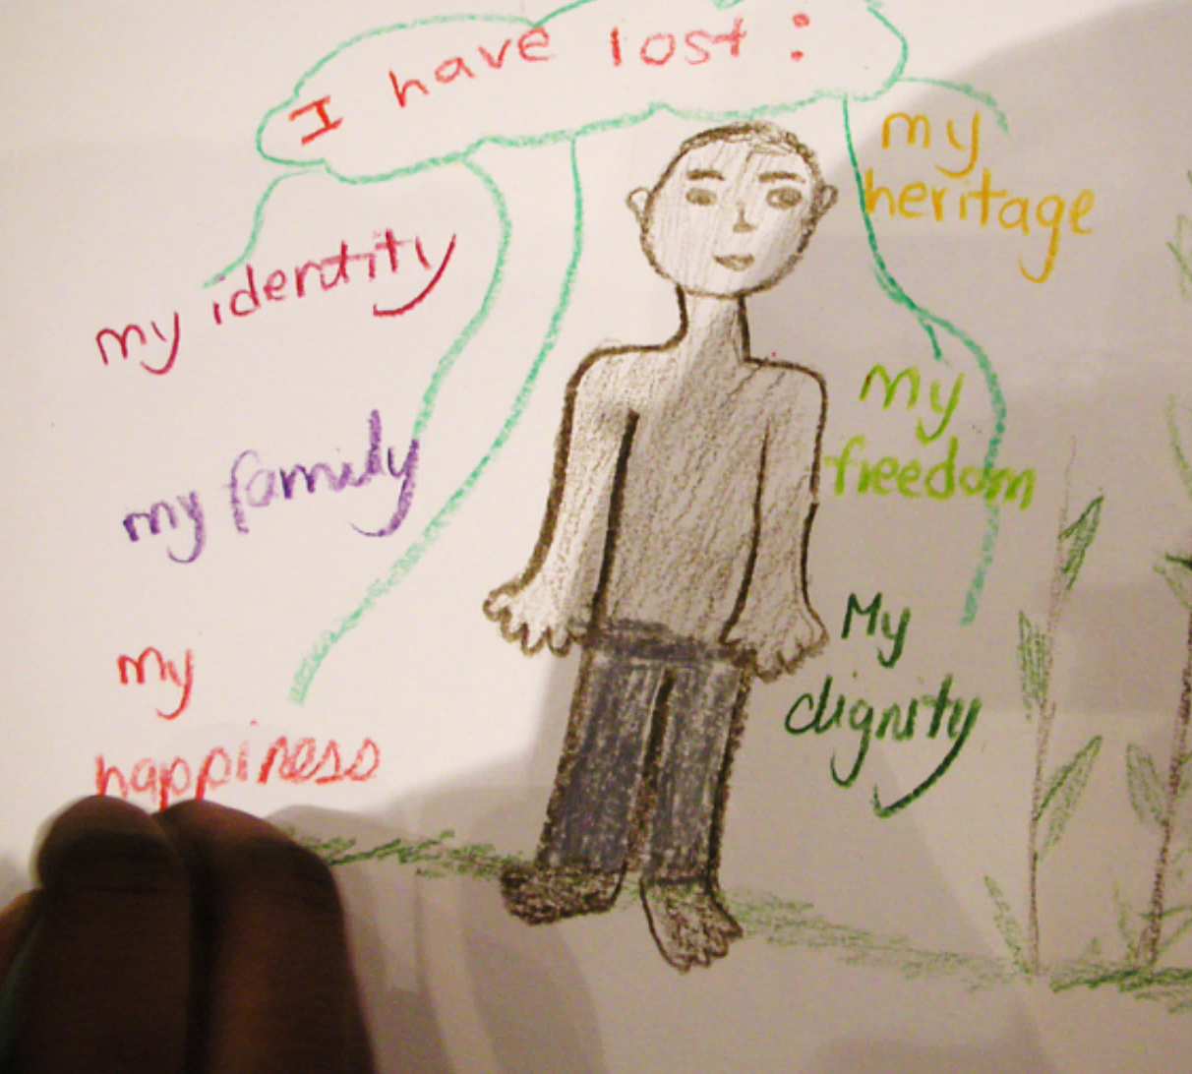
Meysydd dysgu a phrofiad – Y celfyddydau mynegiannol
Area of learning and experience – Expressive arts
Gall pob un o’n straeon ysbrydoli ymatebion creadigol – perfformiad, gair llafar, ysgrifennu creadigol, lluniadu, peintio, allbwn creadigol digidol..
Each of our stories can inspire creative responses – performance, spoken word, creative writing, drawing, painting, digital creative output.

Slide 12
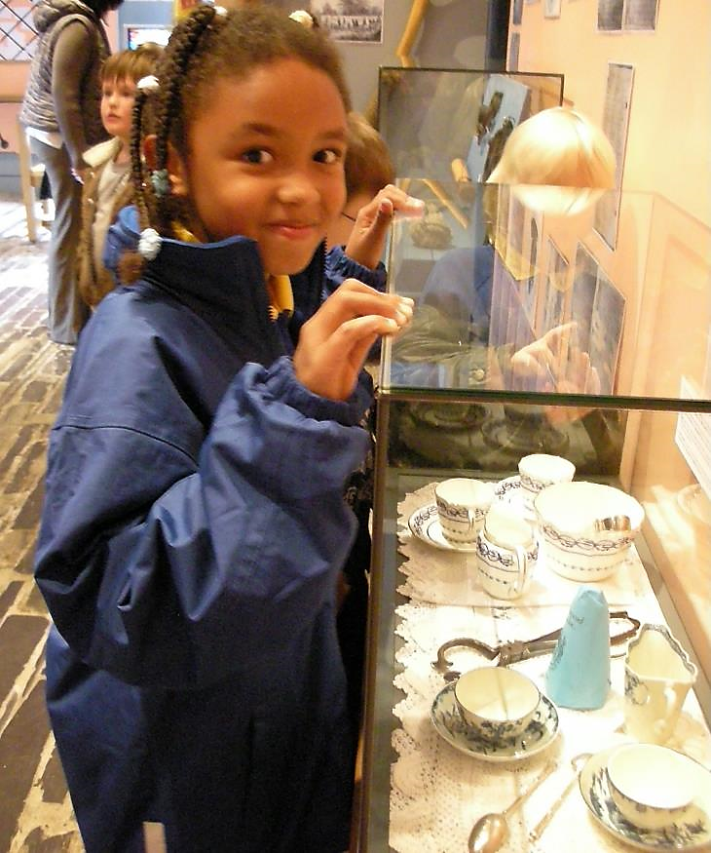
Hanes Pobl Dduon, Asiaidd a lleiafrifoedd ethnig
Black, Asian and minority ethnic histories
Mae gennym ddeunydd i gefnogi eich addysgu, ni waeth ble yng Nghymru yr ydych chi. Gallai hyn gynnwys:
Cofnodion o bobl o wahanol ethnigrwydd yn mynd yn ôl ddegawdau neu hyd yn oed gannoedd o flynyddoedd.
Eitemau o wahanol rannau o'r byd.
Tystiolaeth o bobl leol a gymerodd ran yn yr Ymerodraeth Brydeinig – llyfrau, llythyrau, ffotograffau, eitemau’r cartref, y byd naturiol, offerynnau gwyddonol …
We have material to support your teaching no matter where in Wales you are. This might include:
Records of people of different ethnicities going back decades or even hundreds of years.
Items from various parts of the world.
Evidence of local people who participated in the British Empire – books, letters, photographs, household items, the natural world, military memorabilia, scientific instruments …

Slide 13
Defnyddiwch y sleid hon ar gyfer enghreifftiau o'ch casgliadau eich hun.
Use this slide for examples of your own collections.

Slide 14
Darparu rhagoriaeth addysgol trwy bartneriaethau effeithiol
Delivering educational excellence through effective partnerships
Gwneud i hyn weithio
Making this work
Mae hyn yn newydd i ni, hefyd
Mae Cynllun Gweithredu Cymru Wrth-hiliol Llywodraeth Cymru yn ein hysbrydoli i archwilio ein casgliadau â llygaid newydd. Rydym yn darganfod pethau newydd yn barhaus am yr hyn sydd gennym.
Nid ydym yn athrawon ond rydym yn adnabod ein safleoedd
Rydym wedi ymrwymo i ddysgu am y cwricwlwm newydd fel y gallwn eich helpu. Dywedwch wrthym beth yw eich themâu. Efallai nad ydych yn gwybod yn fanwl beth ydych chi ei eisiau, felly beth am i ni siarad amdano. Mae hon yn daith a rennir.
Sensitifrwydd diwylliannol a phriodoldeb oedran
Rydych yn adnabod eich dysgwyr. Byddwn yn gweithio gyda chi ar yr hyn sy'n briodol iddynt ei archwilio.
Ar gyfer dysgwyr hŷn, gall rhai o'n heitemau annog meddwl yn feirniadol ar amrywiaeth o faterion.
Mae hyn i gyd yn cymryd amser
Trwy siarad gyda'n gilydd, mi lwyddwn ni
This is new for us, too
The Welsh Government’s Anti-Racist Wales Action Plan is inspiring us to explore our collections with new eyes. We are continuously finding out new things about what we have.
We’re not teachers but we do know our sites
We are committed to learning about the new curriculum so we can help you. Tell us your themes. You may not know in detail what you want, so let’s talk it through. This is a shared journey.
Cultural sensitivity and age appropriateness
You know your learners. We will work with you on what is appropriate for them to explore.
For older learners, some of our items can encourage critical thinking on a range of issues.
All of this takes time
Through talking together, we’ll get there

Slide 15
Ymarferion
Practicalities
Gofynnwch i ni am:
Yr amseroedd agor a’r lleoliad
Sut i archebu
Costau fesul disgybl/ysgol
Costau deunyddiau/teithiau/gweithdai
Lleoedd bwyta a thoiledau
Maint y grwpiau
Ystafell addysg bwrpasol
Parcio
Asesiadau risg
Ask us about:
Opening times and location
How to book
Costs per pupil/school
Costs of materials/tours/workshops
Eating spaces and toilets
Size of groups
Dedicated education room
Parking
Risk assessments

Slide 16
Y ffordd ymlaen
The way forward
Ffoniwch neu e-bostiwch ni
Dywedwch wrthym yr hyn yr ydych chi'n edrych amdano
Siaradwch â ni am eich themâu a’r ffordd yr ydych chi’n creuu eich cwricwlwm ar gyfer eich dysgwyr
Phone or email us
Tell us what you’re looking for
Talk to us about your themes and the way you’re building your curriculum for your learners
Rydym yma i'ch helpu chi i feithrin dinasyddion gwybodus a moesegol y byd.
We’re here to help you nurture informed and ethical citizens of the world.

Slide 17
Amgueddfeydd, Archifau a Llyfrgelloedd Astudiaethau Lleol Cymru
Museums, Archives and Local Studies Libraries of Wales
Gweithio mewn partneriaeth ag ysgolion i ddarparu:
Rhagoriaeth addysgol
Cwricwllwm newydd i Gymru
Addysgu hanes Pobl Dduon, Asiaidd a lleiafrifoedd ethnig
Working in partnership with schools to deliver:
Educational excellence
The new Curriculum for Wales
The teaching of Black, Asian and minority ethnic histories
www.gem.org.uk GEM Wales/Cymru

Slide 18
CREDYDAU DELWEDDAU: Mae'r delweddau a restrir isod ar gael trwy Wikimedia Commons
Sleid 1: Gafr Frenhinol Gymreig (a sleid 2) https://commons.wikimedia.org/wiki/File:Royal_welsh_goat_1914.jpg
Jwg te Merched Cymreig https://commons.wikimedia.org/wiki/File:Small_ornamental_jug_with_two_ladies_dressed_in_Welsh_national_costume_sitting_down_to_tea.jpg
Papur Newydd Y Cenhadwr Americanaidd https://commons.wikimedia.org/wiki/File:Y_Cenhadwr_Americanaidd_01.png
Sleid 2: John Ystumllyn (a sleid 5) https://commons.wikimedia.org/wiki/File:Portrait_of_John_Ystumllyn,_1754_%284671107%29.jpg
Sleid 3: Hen rwymiadau llyfrau https://commons.wikimedia.org/wiki/File:Old_book_bindings.jpg.
Sleid 4: Amgueddfa Ceredigion https://commons.wikimedia.org/wiki/File:Ceredigion_Museum_2018_04.jpg
Pier y Rhyl https://commons.wikimedia.org/wiki/File:Rhyl,_View_on_the_Pier_(10575535383).jpg
Sleid 6: Gwyntyll ifori https://upload.wikimedia.org/wikipedia/commons/thumb/c/ce/Carved_ivory_fan%2C_Museum_of_Liverpool.JPG/640px-Carved_ivory_fan%2C_Museum_of_Liverpool.JPG
Sleid 7: Map Caerdydd John Speed https://commons.wikimedia.org/wiki/File:John_Speed%27s_map_of_Cardiff,_Wales_(Town_Hall).jpg
Sleid 8: Gefelau siwgr https://upload.wikimedia.org/wikipedia/commons/thumb/b/b9/Sugarnips62.jpg/640px-Sugarnips62.jpg
Sleid 9: Cofnod cadw cyfrifon https://commons.wikimedia.org/wiki/File:Book-Keeping_modernised-_or,_merchant-accounts_by_double_entry,_according_to_the_Italian_form_Fleuron_T123327-14.png
Mae pob delwedd arall trwy garedigrwydd Marian Gwyn (www.mariangwyn.com) ac at ddefnydd y cyflwyniad hwn yn unig.
IMAGE CREDITS: Images listed below are available via Wikimedia commons
Slide 1: Royal Welsh goat (and slide 2) https://commons.wikimedia.org/wiki/File:Royal_welsh_goat_1914.jpg
Welsh ladies serving tea jug https://commons.wikimedia.org/wiki/File:Small_ornamental_jug_with_two_ladies_dressed_in_Welsh_national_costume_sitting_down_to_tea.jpg
Y Cenhadwr Americanaidd newspaper https://commons.wikimedia.org/wiki/File:Y_Cenhadwr_Americanaidd_01.png
Slide 2: John Ystumllyn (and slide 5) https://commons.wikimedia.org/wiki/File:Portrait_of_John_Ystumllyn,_1754_%284671107%29.jpg
Slide 3: Old book bindings https://commons.wikimedia.org/wiki/File:Old_book_bindings.jpg.
Slide 4: Ceredigion museum https://commons.wikimedia.org/wiki/File:Ceredigion_Museum_2018_04.jpg
Rhyl pier https://commons.wikimedia.org/wiki/File:Rhyl,_View_on_the_Pier_(10575535383).jpg
Slide 6: Ivory fan https://upload.wikimedia.org/wikipedia/commons/thumb/c/ce/Carved_ivory_fan%2C_Museum_of_Liverpool.JPG/640px-Carved_ivory_fan%2C_Museum_of_Liverpool.JPG
Slide 7: John Speed map of Cardiff https://commons.wikimedia.org/wiki/File:John_Speed%27s_map_of_Cardiff,_Wales_(Town_Hall).jpg
Slide 8: Sugar nippers https://upload.wikimedia.org/wikipedia/commons/thumb/b/b9/Sugarnips62.jpg/640px-Sugarnips62.jpg
Slide 9: Bookkeeping record https://commons.wikimedia.org/wiki/File:Book-Keeping_modernised-_or,_merchant-accounts_by_double_entry,_according_to_the_Italian_form_Fleuron_T123327-14.png
All other images are courtesy of Marian Gwyn (www.mariangwyn.com) and are for the use of this presentation only.

